Slide 1
Tutorial
Analysis of recursive algorithms

Slide 2
Theoretical analysis of time efficiency
Time efficiency is analyzed by determining the number of repetitions of the basic operation as a function of input size
Basic operation: the operation that contributes most towards the running time of the algorithm
T(n) ≈ c_{op}C(n)
input size
running time
execution time
for basic operation
Number of times basic operation is executed

Slide 3
Input size and basic operation examples
Problem | Input size measure | Basic operation
Searching for key in a list of n items | Number of list’s items, i.e. n | Key comparison
Multiplication of two matrices | Matrix dimensions or total number of elements | Multiplication of two numbers
Checking primality of a given integer n | n’size = number of digits (in binary representation) | Division
Typical graph problem | #vertices and/or edges | Visiting a vertex or traversing an edge

Slide 4
Best-case, average-case, worst-case
For some algorithms efficiency depends on form of input:
Worst case: C_{worst}(n) – maximum over inputs of size n
Best case: C_{best}(n) – minimum over inputs of size n
Average case: C_{avg}(n) – “average” over inputs of size n
  Number of times the basic operation will be executed on typical input
  NOT the average of worst and best case
  Expected number of basic operations considered as a random variable under some assumption about the probability distribution of all possible inputs

Slide 5
Order of growth
Most important: Order of growth within a constant multiple as n→∞
Example:
  How much faster will algorithm run on computer that is twice as fast?
  How much longer does it take to solve problem of double input size?
Notes:
Example: cn²
how much faster on twice as fast computer? (2)
how much longer for 2n? (4)

Slide 6
Asymptotic order of growth
A way of comparing functions that ignores constant factors and small input sizes
O(g(n)): class of functions f(n) that grow no faster than g(n)
Θ(g(n)): class of functions f(n) that grow at same rate as g(n)
Ω(g(n)): class of functions f(n) that grow at least as fast as g(n)

Slide 7
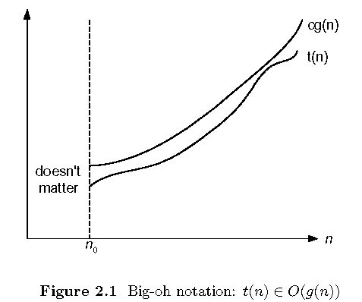
Big-oh

Slide 8
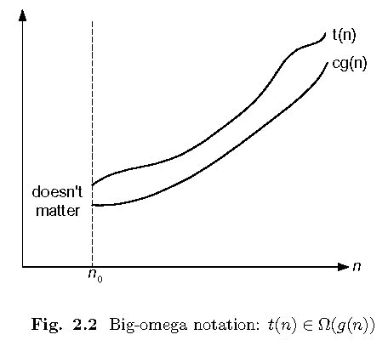
Big-omega

Slide 9
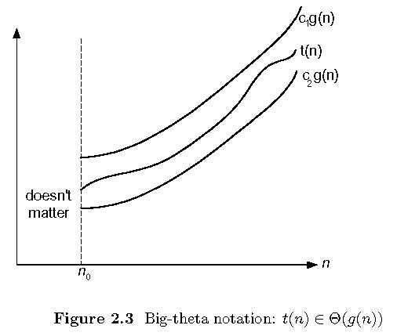
Big-theta

Slide 10
Some properties of asymptotic order of growth
f(n) ∈ O(f(n))
f(n) ∈ O(g(n)) iff g(n) ∈Ω(f(n))
If f (n) ∈ O(g (n)) and g(n) ∈ O(h(n)) , then f(n) ∈ O(h(n))
Note similarity with a ≤ b
If f₁(n) ∈ O(g₁(n)) and f₂(n) ∈ O(g₂(n)) , then
f₁(n) + f₂(n) ∈ O(max{g₁(n), g₂(n)})

Slide 11
Establishing order of growth using limits
0 order of growth of T(n) < order of growth of g(n)
lim T(n)/g(n) =
c > 0 order of growth of T(n) = order of growth of g(n)
n→∞
∞ order of growth of T(n) > order of growth of g(n)
Examples:
10n vs. n²
n(n+1)/2 vs. n²

Slide 12
L’Hôpital’s rule and Stirling’s formula
L’Hôpital’s rule: If lim_{n→∞} f(n) = lim_{n→∞} g(n) = ∞ and
the derivatives f´, g´ exist, then
Stirling’s formula: n! ≈ (2πn)^{1/2} (n/e)^{n}
f(n)
g(n)
f ´(n)
g ´(n)
lim
n→∞
=
lim
n→∞
Example: log n vs. n
Example: 2^{n} vs. n!

Slide 13
Orders of growth of some important functions
All logarithmic functions log_{a} n belong to the same class
Θ(log n) no matter what the logarithm’s base a > 1 is
All polynomials of the same degree k belong to the same class: a_{k}n^{k} + a_{k-1}n^{k-1} + … + a₀ ∈ Θ(n^{k})
Exponential functions a^{n} have different orders of growth for different a’s
order log n < order n^{α} (α>0) < order a^{n} < order n! < order n^{n}

Slide 14
Basic asymptotic efficiency classes
1 | constant
log n | logarithmic
n | linear
n log n | n-log-n
n² | quadratic
n³ | cubic
2^{n} | exponential
n! | factorial

Slide 15
Plan for Analysis of Recursive Algorithms
Decide on a parameter indicating an input’s size.
Identify the algorithm’s basic operation.
Check whether the number of times the basic op. is executed may vary on different inputs of the same size. (If it may, the worst, average, and best cases must be investigated separately.)
Set up a recurrence relation with an appropriate initial condition expressing the number of times the basic op. is executed.
Solve the recurrence (or, at the very least, establish its solution’s order of growth) by backward substitutions or another method.

Slide 16
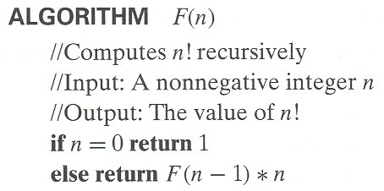
Example 1: Recursive evaluation of n!
Definition: n ! = 1 ∗ 2 ∗ … ∗(n-1) ∗ n for n ≥ 1 and 0! = 1
Recursive definition of n!: F(n) = F(n-1) ∗ n for n ≥ 1 and
F(0) = 1
Size:
Basic operation:
Recurrence relation:
Notes:
Note the difference between the two recurrences. Students often confuse these!
F(n) = F(n-1) n
F(0) = 1
for the values of n!
------------
M(n) =M(n-1) + 1
M(0) = 0
for the number of multiplications made by this algorithm

Slide 17
Analysis of Algorithm F(n)
1.n, the magnitude of the number is the measure on input’s size.
2.Multiplication is the basic operation.
3.Number of times basic operation is executed depends only on the value of n.
4.Set up the recurrence and solve it.
M(n) = M(n-1) + 1, M(0) = 0
M(n) = M(n − 1) + 1 substitute M(n − 1)
= M(n − 2) + 1
= [M(n − 2) + 1]+ 1= M(n − 2) + 2
substitute M(n − 2) = M(n − 3) + 1
= [M(n − 3) + 1]+ 2 = M(n − 3) + 3.
...
= M(n − i) + i = . . . = M(n − n) + n = n ∈ Θ (n) .
5.It is a linear oeder complexity algorithm.

Slide 18
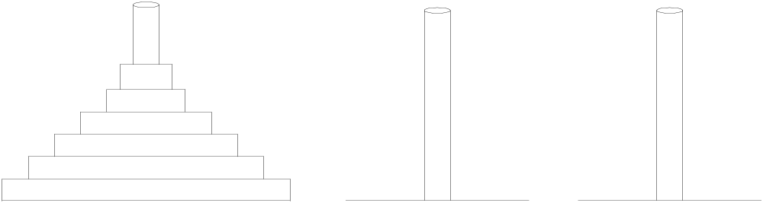
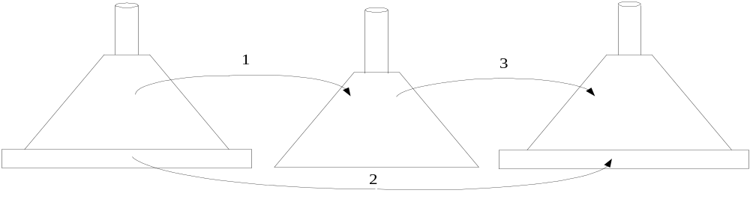
Example 2: The Tower of Hanoi Puzzle
Recurrence for number of moves:

Slide 19
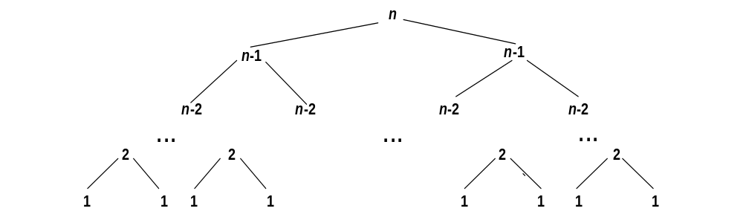
Tree of calls for the Tower of Hanoi Puzzle

Slide 20
Analysis of Towers of Hanoi Algorithm
1.n, the number of discs is the measure on input’s size.
2.Disc Move is the basic operation.
3.Number of times basic operation is executed depends only on the value of n.
4.Set up the sum and solve it.
M(1) = 1.
M(n) = M(n-1) + 1 + M(n-1) for n > 1,

Slide 21
Analysis of Towers of Hanoi Algorithm
1.n, the number of discs is the measure on input’s size.
2.Disc Move is the basic operation.
3.Number of times basic operation is executed depends only on the value of n.
4.Set up the sum and solve it.To
M(1) = 1.
M(n) = M(n-1) + 1 + M(n-1) for n > 1,
To move (n-1)
discs from Source
to Auxiliary
To move (n-1)
discs from Auxiliary
to Target
To move bottom disc
from
source to target

Slide 22
Analysis of Towers of Hanoi Algorithm
1.n, the number of discs is the measure on input’s size.
2.Disc Move is the basic operation.
3.Number of times basic operation is executed depends only on the value of n.
4.Set up the sum and solve it.
M(1) = 1.
M(n) = M(n-1) + 1 + M(n-1) for n > 1,
M(n) = 2M(n − 1) + 1
M(n) = 2M(n − 1) + 1 sub. M(n − 1) = 2M(n − 2) + 1
= 2[2M(n − 2) + 1]+ 1= 2²M(n − 2) + 2 + 1
= 2²[2M(n − 3) + 1]+ 2 + 1= 2³M(n − 3) + 2² + 2 + 1.
=2⁴M(n − 4) + 2³ + 2² + 2 + 1, and generally, after i substitutions,
M(n) = 2 ^{i} M(n − i) + 2 ^{i−1} + 2 ^{i−2} + . . . + 2 + 1= 2 ^{i}M(n − i) + 2 ^{i} − 1.
Since the initial condition is specified for n = 1, which is achieved for i = n − 1, we get the following formula for the solution to recurrence
M(n) = 2 ^{n−1} M(n − (n − 1)) + 2 ^{n−1} − 1
= 2 ^{n−1}M(1) + 2 ^{n−1} − 1= 2 ^{n−1} + 2 ^{n−1} − 1= 2^{n} − 1 belongs to O(2n)
5.It is a exponential ord^{om}er cplexity algorithm.

Slide 23
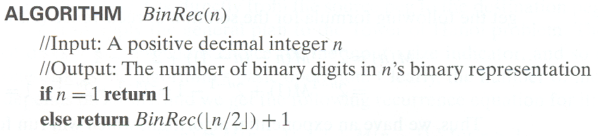
Example 3: Counting #bits

Slide 24
Analysis of Counting no. of bits algorithm
1.n, the magnitude of number is the measure on input’s size.
2.Addition is the basic operation.
3.Number of times basic operation is executed depends only on the value of n.
4.Set up the sum and solve it.
A(1) = 0.
A(n) = A(n/2) + 1 for n > 1.
A(2 ^{k}) = A(2 ^{k−1}) + 1 for k > 0, for n = 2k
A(2 0) = 0.
Now backward substitutions encounter no problems:
A(2 ^{k}) = A(2 ^{k−1}) + 1 substitute A(2 ^{k−1}) = A(2 ^{k−2}) + 1
= [A(2 ^{k−2}) + 1]+ 1= A(2 ^{k−2}) + 2 substitute A(2^{k−2}) = A(2^{k−3}) + 1
= [A(2 ^{k−3}) + 1]+ 2 = A(2 ^{k−3}) + 3 . . .
. . .
= A(2 ^{k−i}) + i
. . .
= A(2 ^{k−k}) + k = A(1) + k = k,
or, after returning to the original variable n = 2 ^{k} and hence k = log₂ n,
A(n) = log₂ n ∈ (log n).

Slide 25
Exercise 1
ALGORITHM S(n)
//Input: A positive integer n
//Output: ???
if n = 1 return 1
else return S(n − 1) + n ∗ n ∗ n
What does algorith S( ) do?
Analyse algorithm S( ) for its performance
Write non-recursive equivalent NRS( ) of algorithm S( )
Analyse algorithm NRS( ) for its performance
Compare the performances of both.

Slide 26
Exercise 2
ALGORITHM Q(n)
//Input: A positive integer n
if n = 1 return 1
else return Q(n − 1) + 2 ∗ n − 1
a. Set up a recurrence relation for this function’s values and solve it to determine that this algorithm computes.
b. Set up a recurrence relation for the number of multiplications made by this algorithm and solve it.
c. Set up a recurrence relation for the number of additions/subtractions made by this algorithm and solve it.

Slide 27
Exercise 3
ALGORITHM Riddle(A[0..n − 1])
//Input: An array A[0..n − 1] of real numbers
if n = 1 return A[0]
else temp←Riddle(A[0..n − 2])
if temp ≤ A[n − 1] return temp
else return A[n − 1]
a. What does this algorithm compute?
b. Set up a recurrence relation for the algorithm’s basic operation count and
solve it.

Slide 28
Exercise 4
ALGORITHM WhoAmI( TREENODE root)
//Input: root node of a tree
if root = null return 0
else return ( 1 + WhoAmI( Lchild(root) ) + WhoAmI( Rchild(root) ) )
a. What does this algorithm compute?
b. Set up a recurrence relation for the algorithm’s basic operation count and solve it.
c. Write non-recursive equivalent of WhoAmI and compare the performances of both.

Slide 29
Solutions to Exercises

Slide 30
Solution to Exercise 1
a. The recursive algorithm computes the sum of the first n cubes: S(n) = 1³ + 2³ + . . . + n³.
b. Analysis :
1) n, number of terms in the series indicates input’s size
2) Multiplication is the basic operation
3) Setting up of recurrence:
M(n) = 0, if n = 1
M(n) = M(n-1) + 2, if n > 1
= [ M(n-2) + 2] + 2 = M(n-2) + 2*2=....
= M(n-i) + i*2= ..... = M(n-(n-1)) + (n-1) *2
= M(1) + (n-1)*2 = (n-1) * 2 ≈ 2n ∈ Θ (n)
4) It is a linear order complexity algorithm

Slide 31
Solution to Exercise 1 contd…
c)
d) Both algorithms belong to same efficiency class
ALGORITHM NRS(n)
//Input: A positive integer
//Output: Sum of the cubic series
if n = 1 return 1
S ←0
for i ←1 to n do
S ←S + i ∗ i * i
return S
Analysis :
M(n) = Σ_{1≤i≤n}2 = 2 Σ_{1≤i≤n} 1 = 2(n-1+1) = 2n ∈ Θ (n)

Slide 32
Hints for Exercise 2
4. a. Note that you are asked here about a recurrence for the function’s values, not about a recurrence for the number of times its operation is executed. Just follow the pseudocode to set it up. It is easier to solve this recurrence by forward substitutions (see Appendix B).
b. This question is very similar to one we have already discussed.
c. You may want to include the substraction needed to decrease n.

